Slide 1

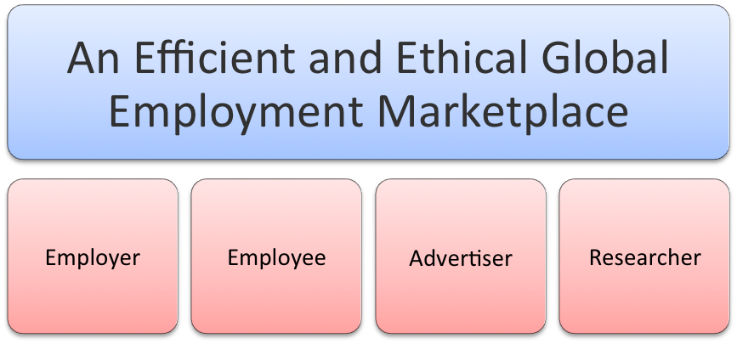
Emphora.com
William Noe: 646.303.1234
Notes:
Don’t like pea green color for title background – use royal blue or purple. Pink boxes don’t make sense -- delete. Use “A Revolutionary Internet Platform” as the title to the next slide, not here.

Slide 2
A Revolutionary Internet Platform
Emphora is a revolutionary web platform that efficiently and ethically connects between employers seeking the best job candidates and employees seeking jobs on a global scale
Join the Revolution
Notes:
Move Title from text box to title box

Slide 3

Leveling the Playing Field
Employers organizations are rated by their employees -- Employees are empowered to protect their legal and moral rights
Notes:
Replace “Emphora.com” with “Leveling the Playing Field” (moved from text box to title box).

Slide 4
Unique in the Market Place
Emphora does not operate like any other employment website you have seen before. It is an immediate and unique solution to a perfect match between an employer and employee
Notes:
Move title from text box to title box.

Slide 5
Emphora is the Brainchild of . . .
Mel Heravian PhD in Aerospace Engineering with 20 years experience in Computer Architecture and Systems Design & Programing
Moshe Banai PhD, Professor of Human Resource Management with over 25 years experience in international HR consulting
David Miller PhD, Professor of Mathematics with 15 years experience in scientific consulting
William Noe MBA from Harvard with 30 years experience in early stage business and finance
Emphora.com

Slide 6
Today. . .
“Employers and Employees suffer from insufficient and unreliable information in their efforts to match employers’ requirements with employees’ qualifications”
Emphora.com

Slide 7
A Few Years into the Future . . .
Everyone is empowered with a “eLifeBook™” curated by Emphora.com:
A person’s eLifeBook™ contains credible ratings of performance at various stages in their careers and credentials authenticated whenever possible
Just as lenders make decisions today based on credit reports, Employers will be able to rely on Emphora.com eLifeBooks™ to extract the meaningful and authentic information they need to make efficient hiring decisions
Emphora.com

Slide 8
Emphora Mission Statement . . .
Emphora.com mission is to be an efficient and ethical market for global talent, where Employers search for the right persons to hire and Employees and Consultants evaluate their best match in terms of skills, environment and value – all with anonymity and security
The vision of Emphora.com is that it will curate a virtual eLifeBook™ for every person that confirms their personal history with ratings that are credible and credentials that have been authenticated
Emphora.com

Slide 9
Companies Using Emphora . . .
Companies seeking employees are able to…
Avoid unnecessary payments to employment agencies and headhunters
Locate potential employees efficiently and economically
Evaluate cost of skill sets and experience
Confirm availability and cost of global talent during the planning process
Save time and energy of managers and HR personnel
Emphora.com

Slide 10
Individuals Using Emphora . . .
Individuals seeking employment are able to…
Document the caliber of their skills and to be recognized for their star qualities
Get the attention of “best match” Employers
Be rated objectively against similarly qualified candidates and adjust their fees accordingly
Improve their outdated skills and lagging performance ratings
Maintain productive relationships with previous Employers and with peers
Emphora.com

Slide 11
The Emphora Platform
Emphora deploys a creative new solution:
Curates a database of employees and employers with statistically valid rating information
Implements state-of-the-art matching algorithms to connect participants
Provides employees with extensive support to develop and document competencies
Maintains total anonymity and confidentiality for all participants until mutual consent allows contact
Provide tools for Employers to determine staffing and estimating costs for projects
Emphora.com
Notes:
Added “allows contact” to 4th line.

Slide 12
Emphora Provides Authenticity
Emphora emphasizes confidentiality, security and authentication:
100% Anonymity – No search will ever produce a person's name, only a member ID
Mutual Consent - Employers and interested prospective employees are connected only with their mutual consent
Verification - No report on an individual or a company gets included in a rating unless the provider is verified
Authentication - Employee credentials (certifications, degrees, awards, etc.) are authenticated when possible
Emphora.com
Notes:
Use title on Slide 16 (was 14).

Slide 13
Emphora Revenue Model
Revenues are derived from fees collected from:
Employers who use the platform to search for prospective employees
Employees who need to drill down into their ratings, refine their competencies and improve their ratings
Advertisers, such as businesses that provide services to help employees build their competencies through training and skill development and others who need to reach targeted employment sectors efficiently
Researchers who want access to the anonymous database
Emphora.com
Notes:
If you want to use the pink boxes on the first slide, put here.

Slide 14

Time Table
Development of the Beta Platform requires three months
Development of the fully functional Internet Platform requires six months
Testing and Launching of the Emphora.com platform requires six months
Estimated development budget of $1 million, followed by $5 million marketing budget to launch Emphora.com in the world market
Emphora.com

Slide 15
Financial Considerations
EMPHORA ADDRESES A MULTI-BILLION DOLLAR WORLD MARKET
Potential Revenues in Year 2 $24,000,000
Potential Net Profit in Year 2 $ 6,000,000
Budget to Launch Emphora at EOY Year 1 $ 5,000,000
Budget for Software Development $ 1,000,000
  Cost to Develop Prototype $200,000
  Cost to Deliver Beta Product $300,000
  Cost to Complete Software Development $500,000
Emphora.com
Notes:
Changed order of Budget line to go earliest to latest.

Slide 16
Emphora Makes Confidentiality and Authentication Paramount
Internet-based resume and job posting sites and professional networking sites do not verify skill claims and do not allow for competency-based matching
Traditional employment agencies profit from hiring and provide only candidates supported by "word of mouth," not statistically valid ratings of skills and authenticated credentials that match the employers' needs
Emphora.com
Notes:
This should be the title of Slide 12. New title: Legacy of Current Practices

Slide 17
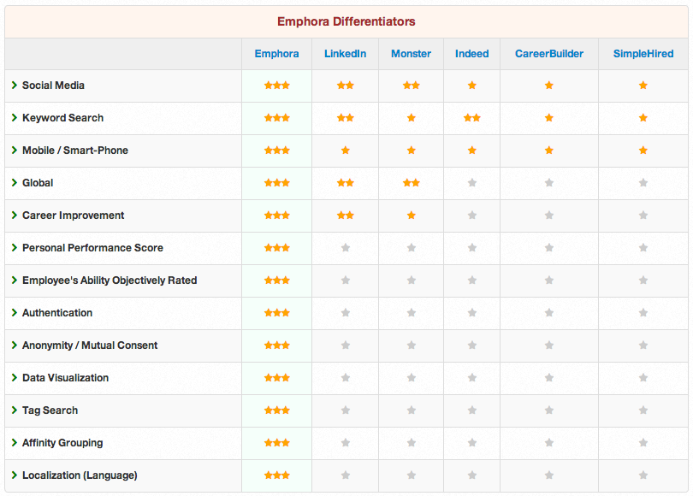
Emphora’s Differentiators
Emphora.com
Notes:
Delete “at a glance” from title.

Slide 18
Personal Performance Score
Differentiators
Emphora.com
Competition
Each employee has a dynamic global personal performance score that is updated automatically
Employer has no objective way to evaluate the candidate other than the candidate’s testimony
Emphora.com

Slide 19
Employee’s Performance Evaluation
Differentiators
Emphora.com
Competition
Employee's ability is objectively rated by his superiors, peers and subordinates
Employee’s ability is evaluated by his previous employer, who is reluctant to provide objective assessment
Emphora.com

Slide 20
Authentication
Differentiators
Emphora.com
Competition
Employees knowledge, abilities and skills are authenticated by the educational and training institutions submitted by the employee
Employee knowledge, abilities and skills are provided by the employee with no verification
Employees often ‘embellish’ their credentials
Emphora.com

Slide 21
Anonymity Until Mutual Consent
Differentiators
Emphora.com
Competition
Job applicant's identity is unknown to potential employer until the applicant agrees to expose his/her identity
Job applicant’s identity is known to potential employer throughout the selection process, introducing bias to the decision and exposing the applicant publicly
Emphora.com

Slide 22
Data Visualization
Differentiators
Emphora.com
Competition
Data are presented in colorful charts, graphs and images that provide both employer and employee with quick visualization of trends, ratios, weights, etc.
Data are copied from hard copies into computer fields with no additional advantages
Emphora.com

Slide 23
Tag and Keywords Search
Differentiators
Emphora.com
Competition
Employees and employers can match up with one another efficiently by simply clicking on a few key words
Employees and employers identify each other through a lengthy and expensive process of exchanging job descriptions and specifications with resumes and credentials
Emphora.com

Slide 24
Career Management
Differentiators
Emphora.com
Competition
Employees are able to identify their actual employment market shortcomings and can formulate a career plan to enhance their competencies and improve their ratings
Employees relate to some information that advises them of ways to enhance their career opportunities
Emphora.com

Slide 25
Affinity Grouping and Social Media
Differentiators
Emphora.com
Competition
Employees and employers use Emphora to automatically identify others who share similar interests globally
Employees and employers can click into links to affinity group service providers that are independent of the job platform
Emphora.com

Slide 26
Global Reach
Differentiators
Emphora.com
Competition
Employees and employers ‘meet’ each other globally on Emphora
Employee and employer ‘meet’ each other locally in most other platforms
Emphora.com

Slide 27
Localization
Differentiators
Emphora.com
Competition
Employees and employers can communicate with each other in almost any language without having command of that language
Employees and employers must communicate in English
Emphora.com

Slide 28
Global Communication Devices
Differentiators
Emphora.com
Competition
Employees and employer use their Smartphones, tablets and computers – or any other communication devices that connect to the Internet
Employees and employers use computers tied to the Internet
Emphora.com

Slide 29
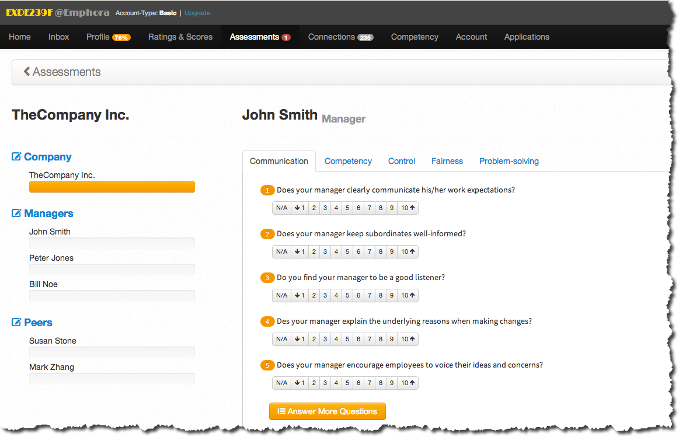
Emphora Provides Productivity
Emphora.com

Slide 30

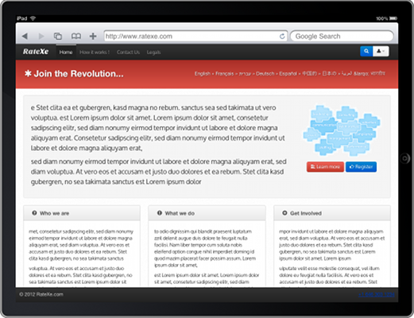
Emphora Delivers Where You Are
Emphora.com

Slide 31
Possible Alternatives
Emphora.com

Slide 32
Emphora’s Differentiators
Personal Performance Score | Each employee has a dynamic global personal performance score that is updated automatically
Employee’s Performance Evaluation | Employee's ability is objectively rated by his superiors, peers and subordinates
Authentication | Employees knowledge, abilities and skills are authenticated by the educational and training institutions submitted by the employee
Anonymity Until Mutual Consent | Job applicant's identity is unknown to potential employer until the applicant agrees to expose his/her identity
Tag and Keywords Search | Employees and employers can match up with one another efficiently by simply clicking on a few key words
Career Management | Employees are able to identify their actual employment market shortcomings and can formulate a career plan to enhance their competencies and improve their ratings
Affinity Grouping and Social Media | Employees and employers use Emphora to automatically identify others who share similar interests globally
Emphora.com
Notes:
Impact is gone! Go back to the original individual slides that show Emphora on the left and Legacy on the right – that’s much to powerful to throw away.

Slide 33
Emphora’s Differentiators
Continued
Global Reach | Employees and employers ‘meet’ each other globally on Emphora
Localization | Employees and employers can communicate with each other in almost any language without having command of that language
Global Communication Devices | Employees and employer use their Smartphones, tablets and computers – or any other communication devices that connect to the Internet
Data Visualization | Data are presented in colorful charts, graphs and images that provide both employer and employee with quick visualization of trends, ratios, weights, etc.
Automated Profiling | No Searching is required. Employers log into Emphora.com and the candidates’ profiles line up in a preference order set up by the employer
Emphora.com

